Slide 1
Analytics Project:
Gender
Discrimination Lawsuit
Analytics Consultant for the Female Doctors

Slide 2
Thesis Statement
Analytics Consultant for Female Doctors
Fighting for female plaintiff’s cause
Hence, proving our claim by showing data suggesting discrimination against female doctors, compared to male counterparts

Slide 3
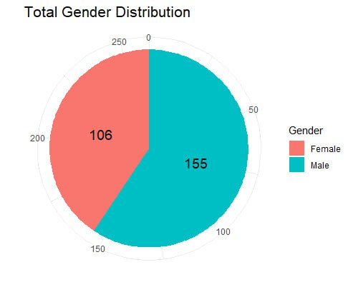
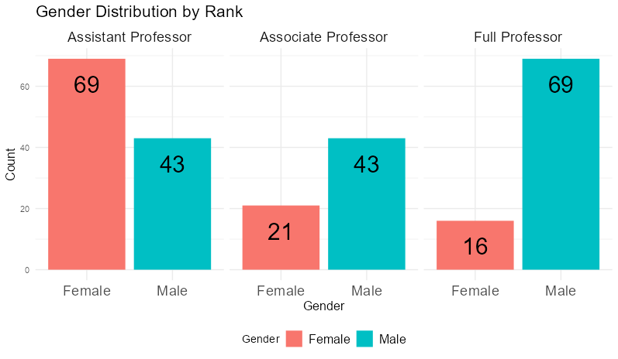
Data Exploration: Gender Distribution
Gender distribution skewed towards males, which is of higher proportion than females
Uneven gender distribution across ranks
higher proportion of females in
the Assistant Professor rank
higher proportion of males in
the Full Professor rank

Slide 4
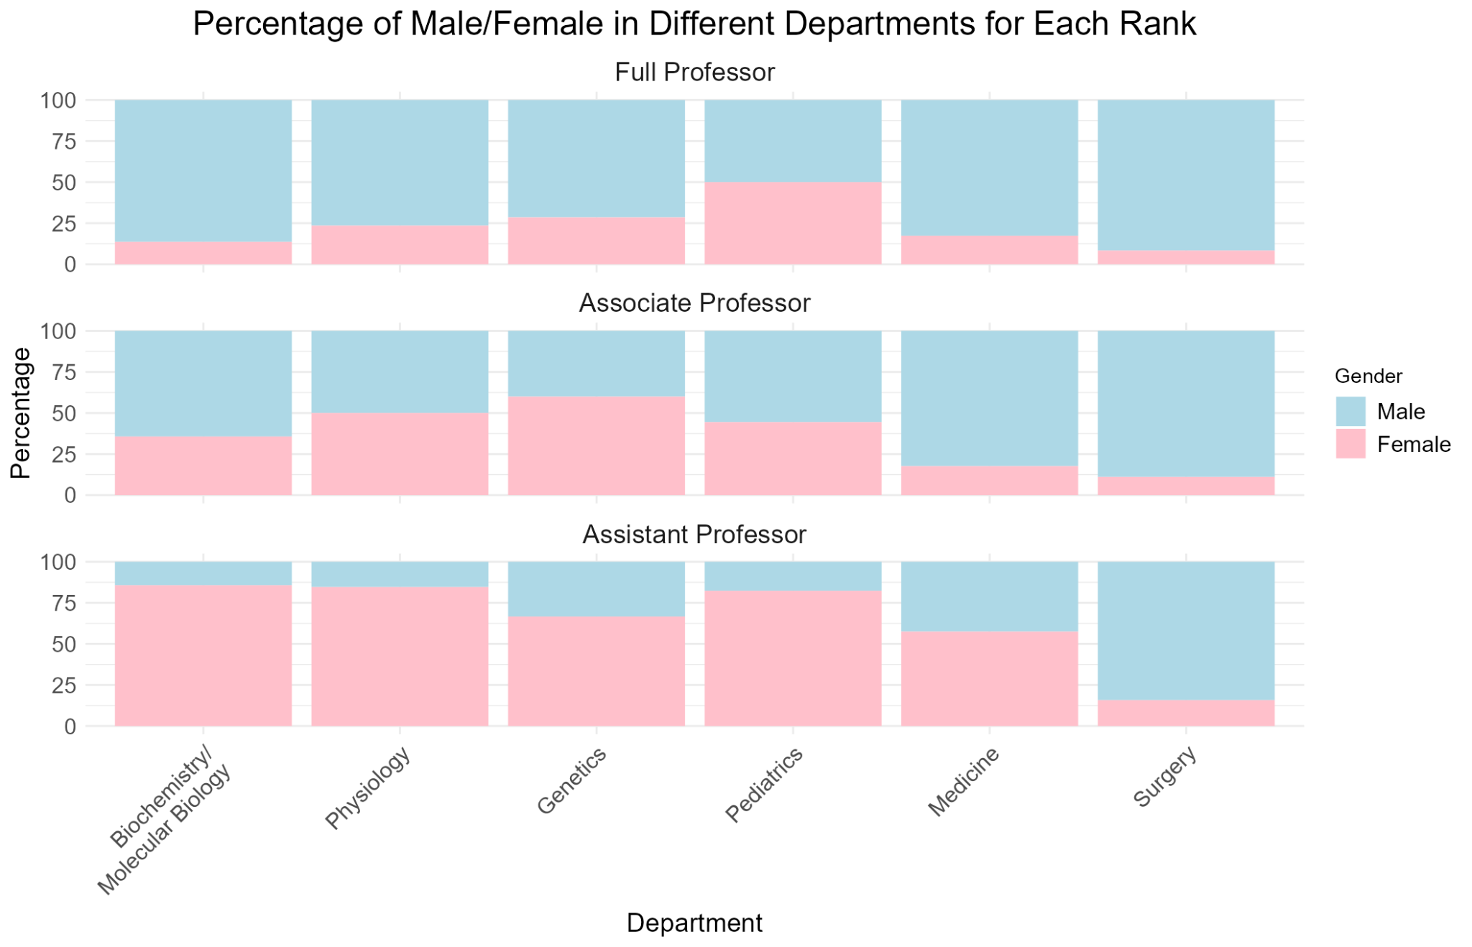
Percentage Distribution of Genders Across Ranks (Arranged by Department)
This stacked bar graph illustrates the distribution of genders within various departments across different ranks.
Gender distribution across ranks
Full Professors
Higher proportion of Males compared to Females across all departments
Associate Professors
Somewhat balanced gender distribution
Assistant Professors
Higher proportion of Females across most departments
Conclusion
Disparity in gender representation
Males predominantly distributed at Full Professor level
Females concentrated at Assistant Professor level

Slide 5
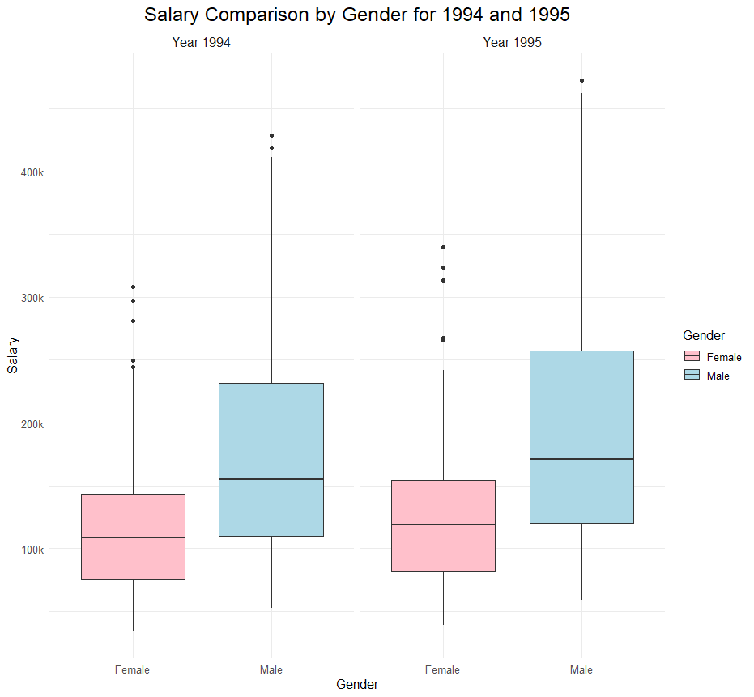
T-Test on Differences in Mean Salaries
Welch’s T-Test:
Variances/Sample Sizes are different
Year 1994
Year 1995
As a whole population, is it true to say that the females have on average a lower salary than the males?
Null Hypothesis: The female mean salary is equal to the male mean salary (for both years)
data: female_sal94 and male_sal94
t = -6.6457, df = 258.53,
p-value = 1.778×10⁻¹⁰ (<<0.05)
Reject Null Hypothesis:
True difference in means is not equal to 0
Mean(Female Pay) vs Mean(Male Pay)
118871.3 vs 177338.8
data: female_sal95 and male_sal95
t = -6.5905, df = 258.53,
p-value = 2.446×10⁻¹⁰ (<<0.05)
Reject Null Hypothesis:
True difference in means is not equal to 0
Mean(Female Pay) vs Mean(Male Pay)
130876.9 vs 194914.1
Females earn 33.0% less than Males ON AVERAGE in 1994
Females earn 32.9% less than Males ON AVERAGE in 1995
Reasonable to conclude that there exists discrimination of salaries between Genders

Slide 6
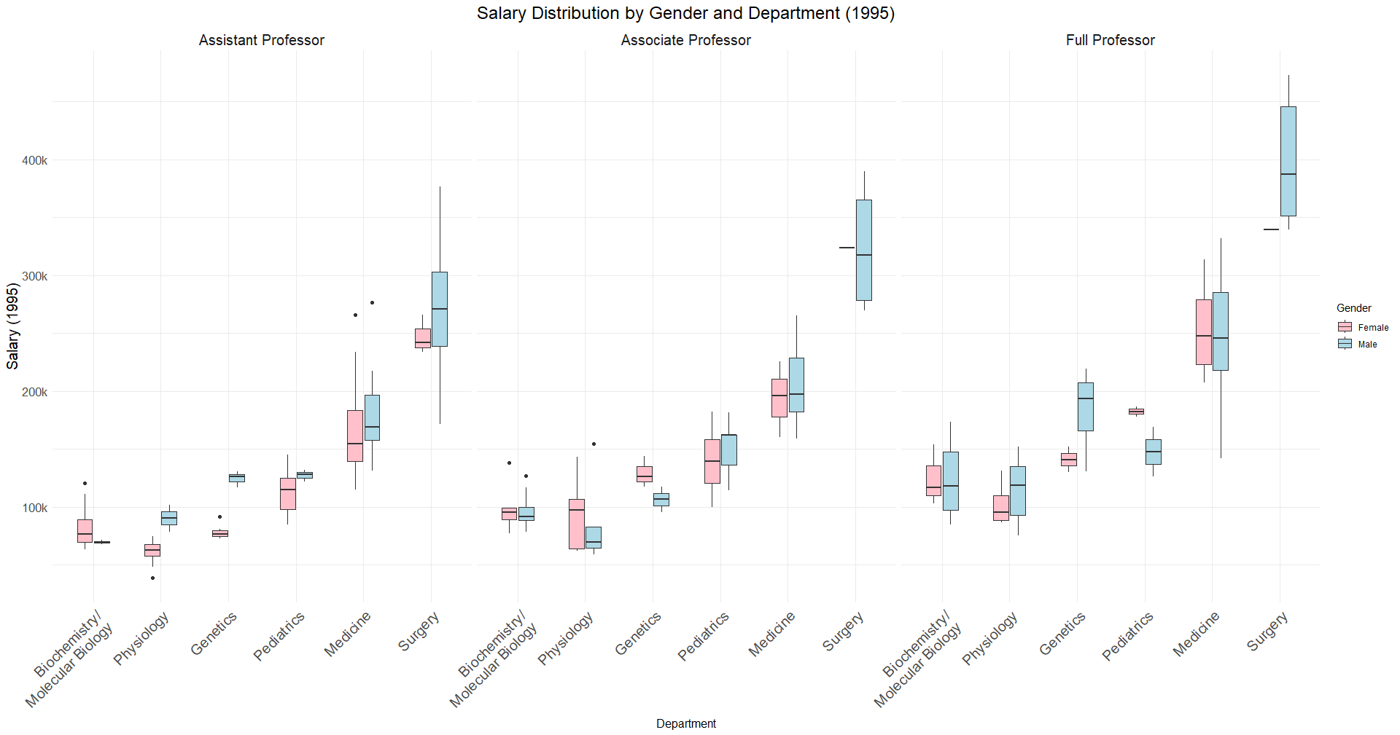
Salary Distribution
Circles in Red highlights the females (sorted by department and rank) that are susceptible to salary discrimination
While there exists discrimination in some departments, we recognize that other departments may not share the same sentiments (highlighted in Blue)

Slide 7
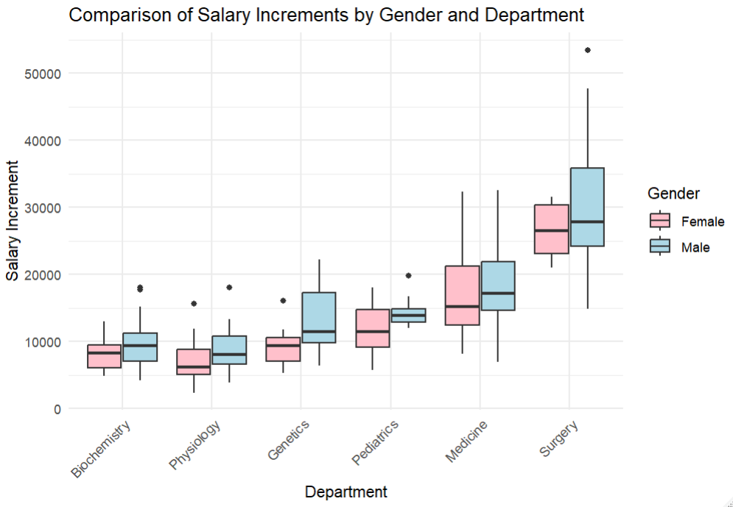
Salary Increment Comparison
The boxplots show the comparison between the salary increment of men and women in 1994 in 1995, within each department.
Overall trend: In general, the box plot shows that men mostly receive a higher salary increment in comparison to women in all the different departments. This supports our argument that there is discrimination against women, as their salary is increasing at a slower rate than men within the same department.

Slide 8
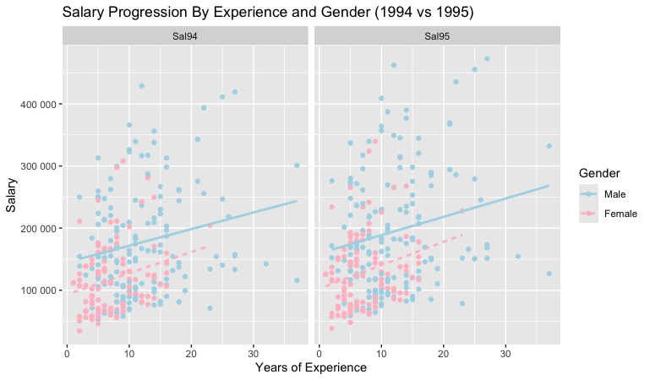
Salary Progression By Experience & Gender
This is Salary Progression based on Gender and Experience for Year 1994 and 1995.
We can see from the red box at 10 Years of Experience the pink dots (females) are more clustered towards lower salary end between 100,000 and 200,000. The blue dots (males) whereas are clustered around the higher salary end between 200,000 to 300,000.
There is discrimination of salaries between genders despite same years of experience

Slide 9
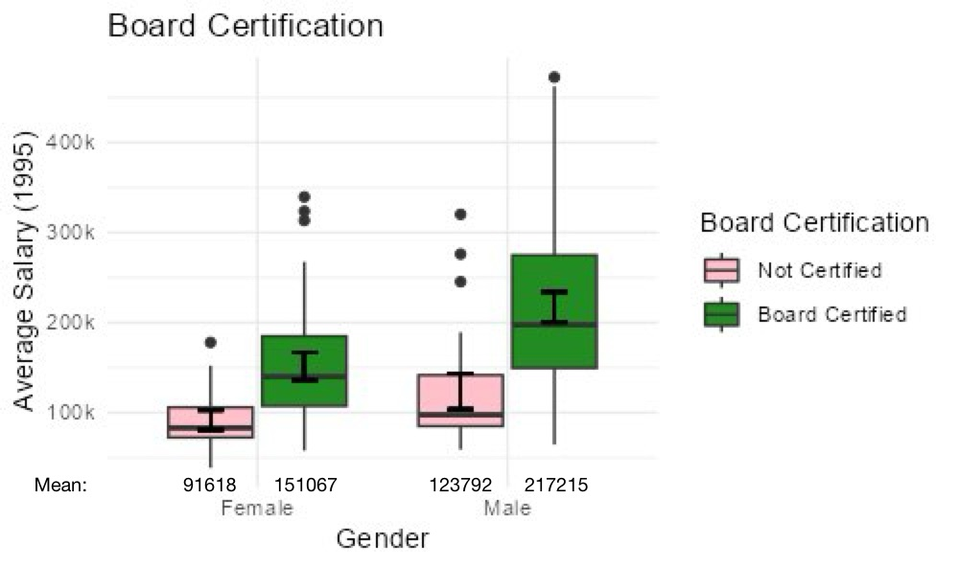
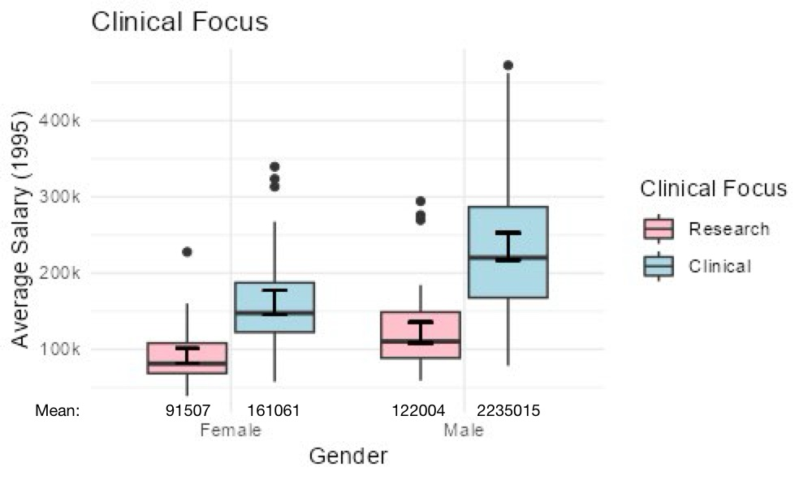
Gender vs Salary by Board Certification and Clinical Focus
Mean and median salary (1995) for males higher than females’,
regardless of board certification and clinical focus
Males experience greater salary increment than females, when they become board certified or switch "Research" to "Clinical"
Gender discrimination in salary → lower pay for females

Slide 10
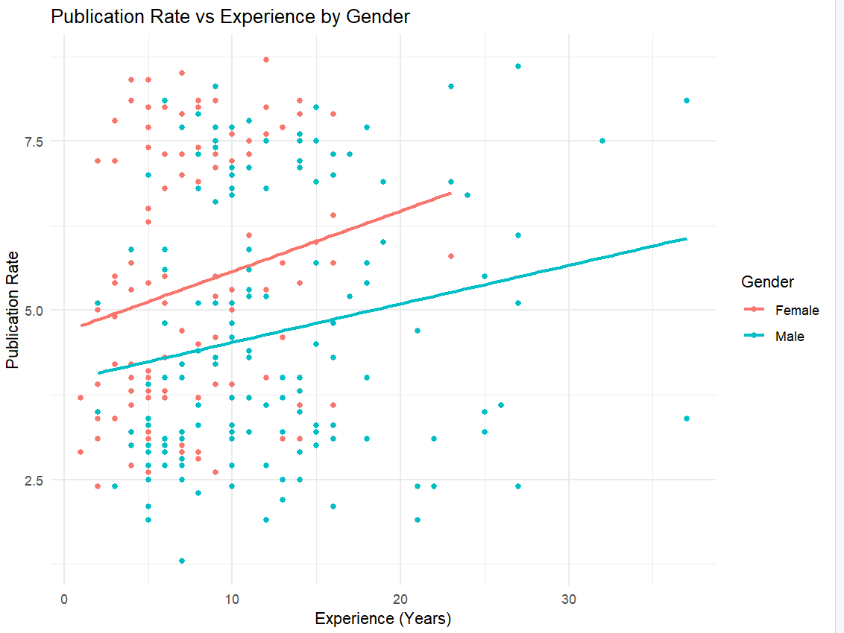
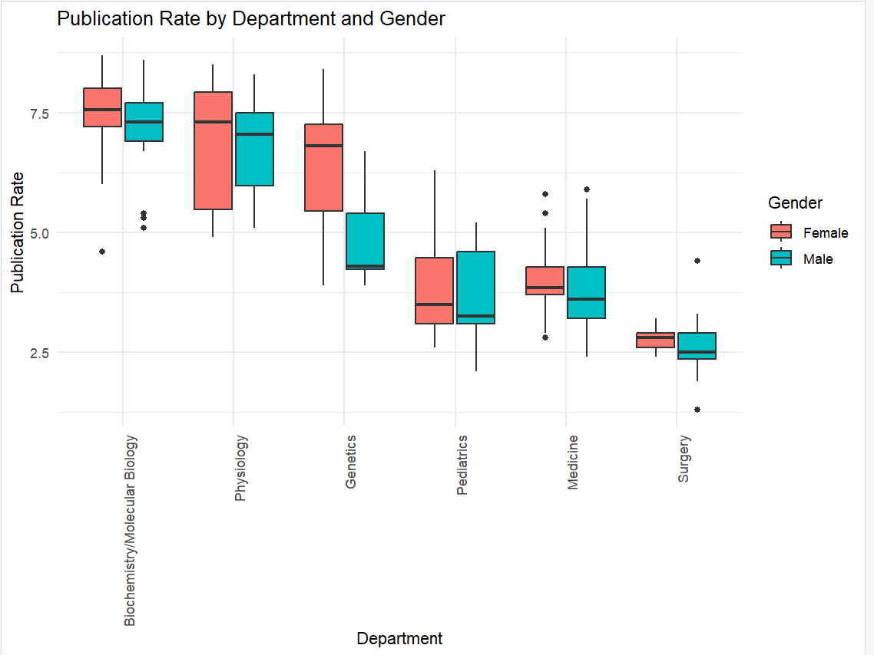
Publication Rate by Gender and (Exp, Dept)
Female doctors show higher publication rates than males, especially in early to mid-career stages.
Despite higher productivity, female doctors face slower career progression and potential salary gaps.
In research departments like Biochemistry and Physiology, females outperform males in publication rates, yet still encounter barriers to recognition and advancement.
Clear evidence of gender discrimination in academic productivity vs. career outcomes.

Slide 11
Conclusion
Gender Distribution
Salary
Disparities
Publication Performance
Yee Hey
Females underrepresented at higher faculty ranks, while males are overrepresented
Females earn less than males on average
Females experience lower salary growth than males
Females outperform males, but career recognition is not reciprocated
There is systemic gender discrimination in salary and career advancement against females, despite comparable qualifications, experience, and performance as males.

Slide 12
Appendix

Slide 13
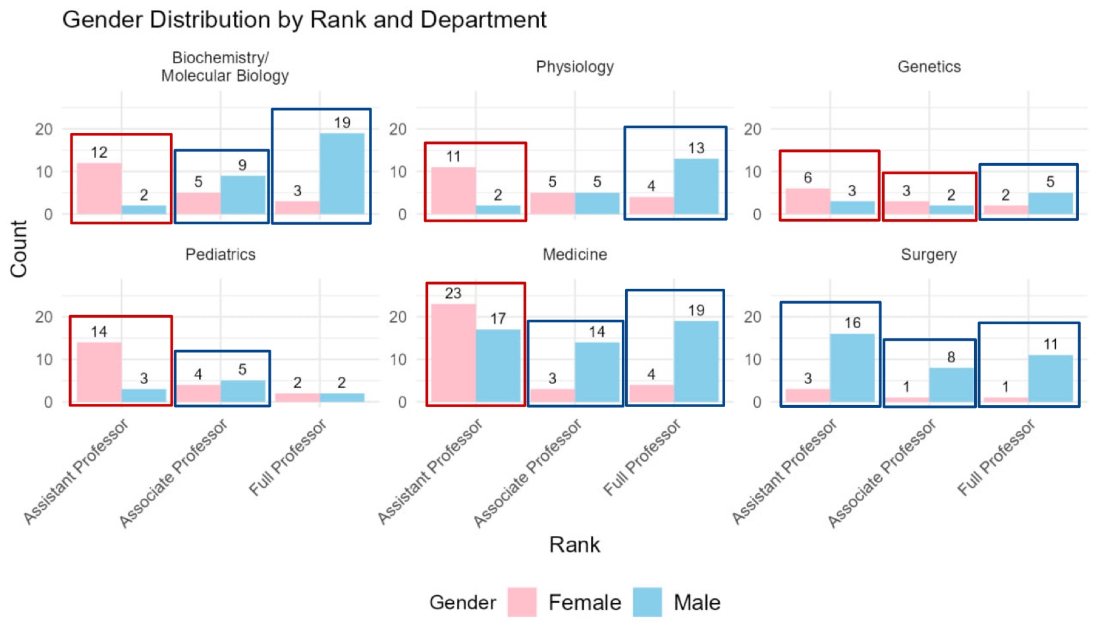
Data Exploration: Gender Distribution
Uneven gender distribution across ranks and departments, with a higher proportion of males, especially in higher ranks.
As individuals progress through the ranks (from Assistant Professor to Full Professor), the proportion of males generally increases, while the proportion of females decreases.
Boxed in Red: Number of females more than males
Boxed in Blue: Number of males more than females

Slide 14
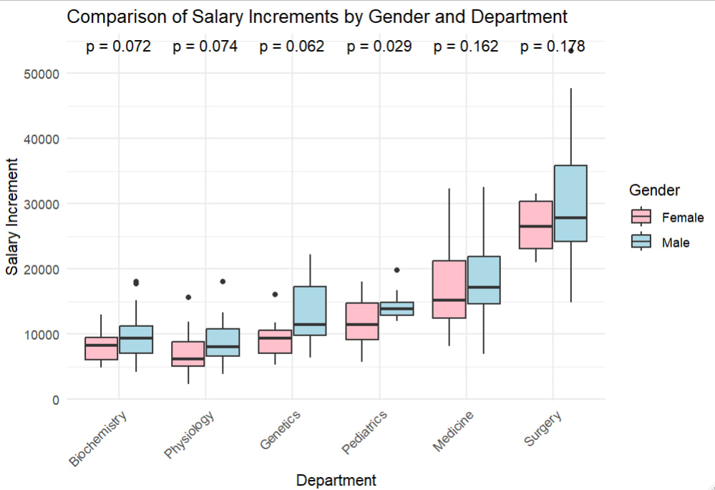
Salary Increment Comparison
If p-value < 0.05, the difference is statistically significant.
If p-value ≥ 0.05, the difference is not statistically significant
The test results show that in the Pediatrics department the p-value = 0.029, which shows that the difference between salary increments between males and females is statistically significant. It supports that men are more favourably rewarded than women in terms of salary increases.

Slide 15
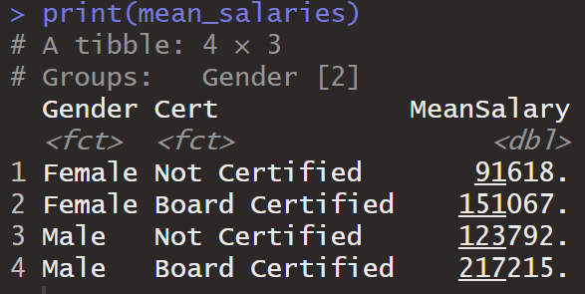
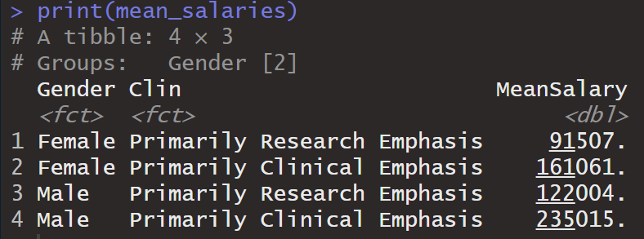
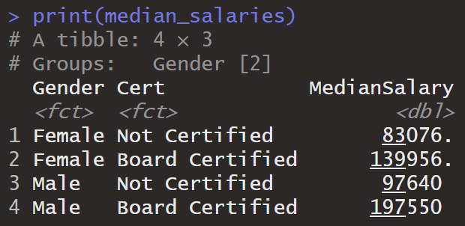
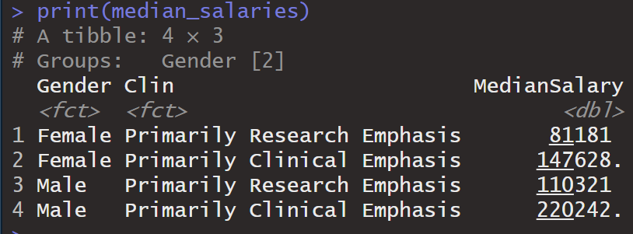
Gender vs Salary by Board Certification and Clinical Focus
Board Certification
Clinical Focus
Mean and median salary (1995) for males higher than females’, regardless of board certification and clinical focus → Gender discrimination in salary

Slide 16
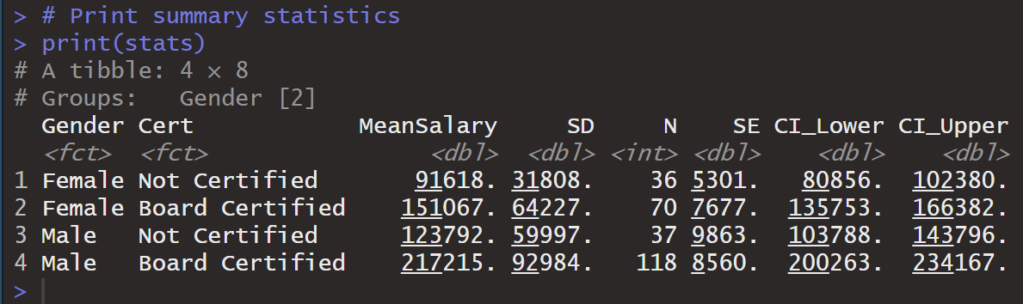
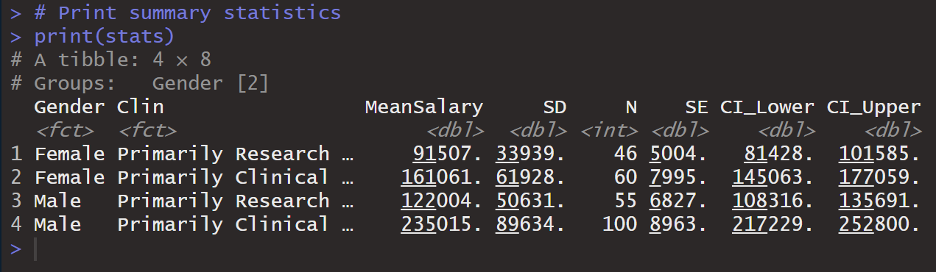
Gender vs Salary by Board Certification and Clinical Focus: Confidence Interval
Board Certification
Clinical Focus
Non-overlapping of CIs between genders → suggests potential statistical difference in mean salary between genders at 95% confidence interval
Hence: 95% confident that there is gender discrimination in mean salary –
lower pay for females, even when considering board certification and clinical focus

Slide 17
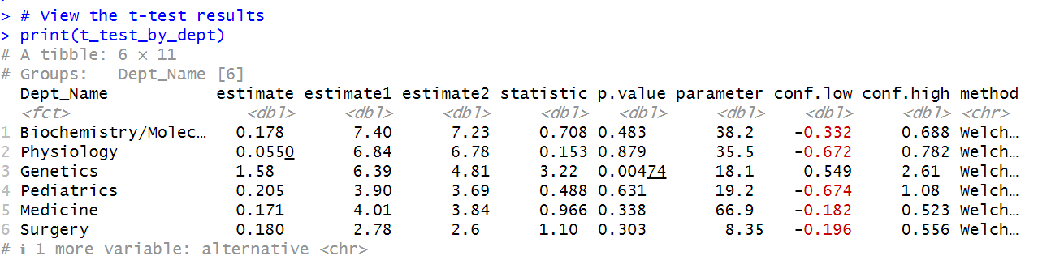
T-Test for Publication Rate by Department and Gender
estimate1: The mean publication rate for females.
estimate2: The mean publication rate for males.
p.value: The p-value, which indicates whether the difference in publication rates between males and females is statistically significant.
If p-value < 0.05, the difference is statistically significant.
If p-value ≥ 0.05, the difference is not statistically significant
The t-test results show that in Genetics, female doctors have a significantly higher publication rate than their male counterparts (p = 0.00474). This provides clear evidence that female doctors are more productive, yet are not compensated accordingly, indicating gender discrimination.

